Slide 1

고조선
Notes:
고조선

Slide 2

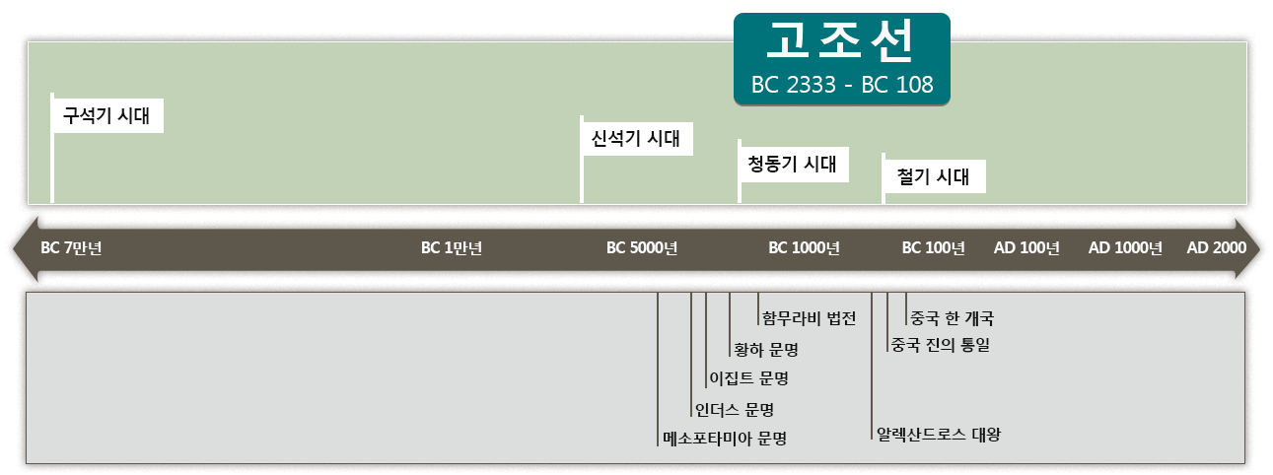
세계속의 고조선
기원전 2333년
Notes:
The first country on the Korean Peninsula was called 고조선. 고조선 was around from 2333 BC to 108 BC. It was established in the Bronze Age and lasted to the early Iron Age.
Look at this timeline, you can see the time when the Mesopotamian civilization, the Indus civilization, the Egyptian civilization, and the Yellow River civilization all emerged.

Slide 3
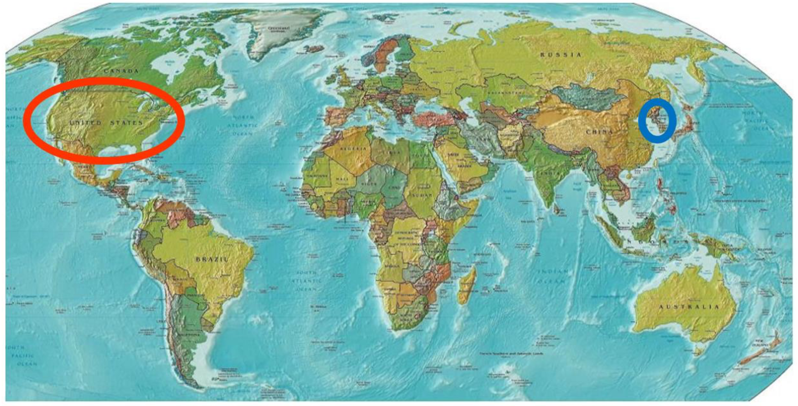
Notes:
Can you find Korea and the US on this map?

Slide 4
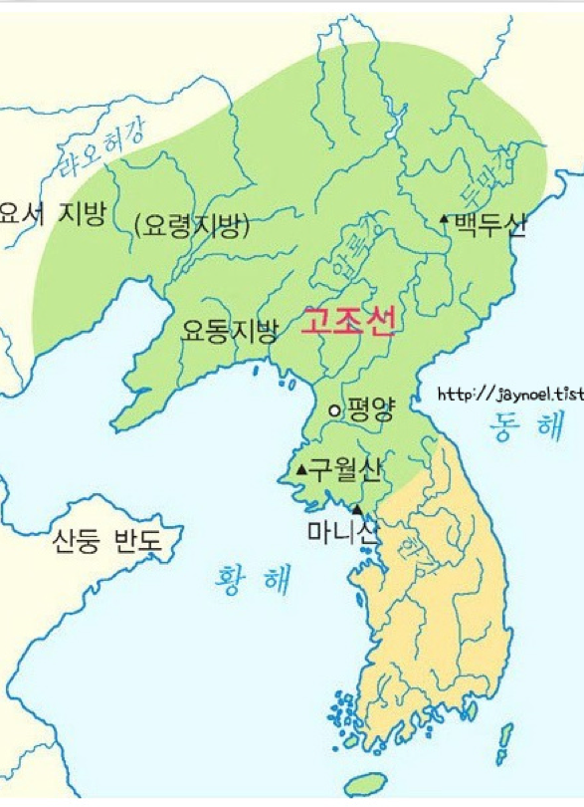
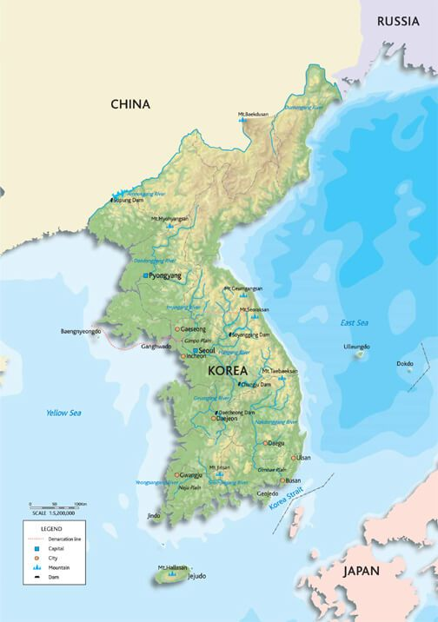

고조선
영역
도읍지: 아사달(평양)
고조선은
어디였을까?
(도읍지: 아사달)
Notes:
The map on the left is a map of South Korea and North Korea. The map on the right shows the territory of 고조선, the first country built on the Korean Peninsula. It covers South Korea, North Korea, and even further north. The capital of 고조선 was 아사달, which is now 평양.

Slide 5
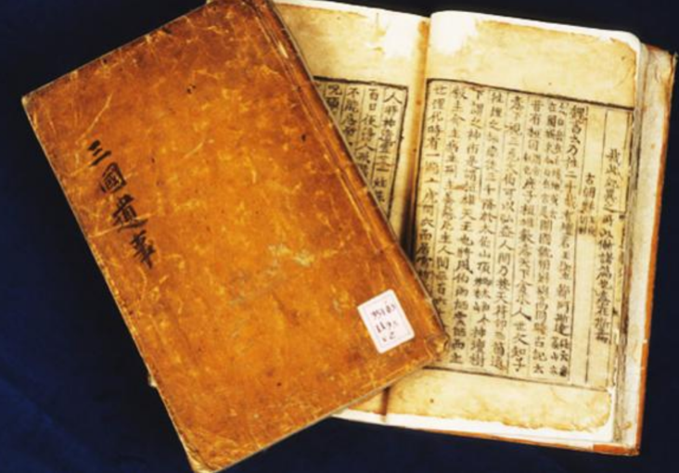
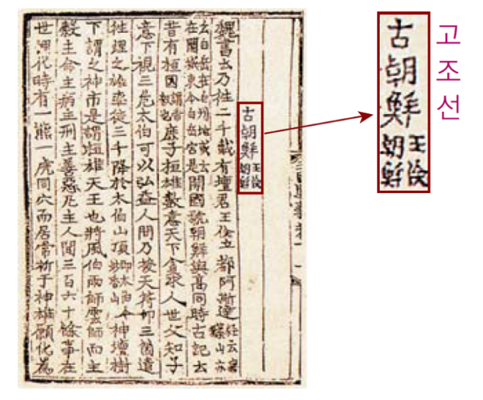
삼국유사
저자 : 일연
고조선부터 한국 역사의 시작
하늘의 뜻을 따르는 고귀한 민족
Notes:
The first Korean record that introduced 고조선 is “삼국유사”. The 단군신화, the story of 단군왕검 was recorded in this book written by 일연 during the 고려 Dynasty. He wanted to show that the Korean people were chosen and could overcome difficult times because at that time 고려 was suffering from the invasion from China, the Yuan Dynasty.

Slide 6
건국이념
홍익인간
弘(넓을 홍) 益(더할 익) 人(사람 인) 間(사이 간)
널리 인간을 이롭게 한다
Notes:
The founding ideology of 고조선 is '홍익인간'. This means 'widely benefiting humans.'

Slide 7
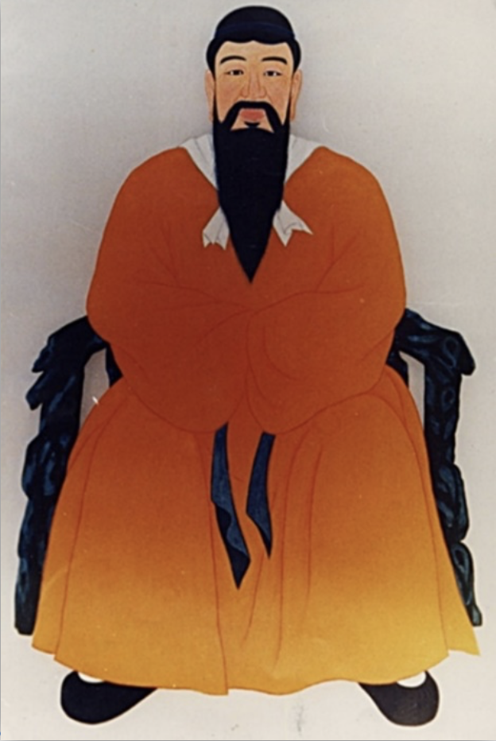
단군왕검
한민족의 신화적인 시조
고조선을 세운 국조
단군 : 제사장
왕검 : 지도자
Notes:
The person who founded 고조선 was called 단군왕검. '단군' means priest, and '왕검' means political leader. 단군왕검 doesn’t refer to one person but refers to the position or the title of a person who ruled 고조선.

Slide 8
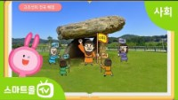
https://www.youtube.com/watch?v=9yDuYu5Mgs4&feature=emb_title
Notes:
Let’s watch the story of 단군왕검.

Slide 9
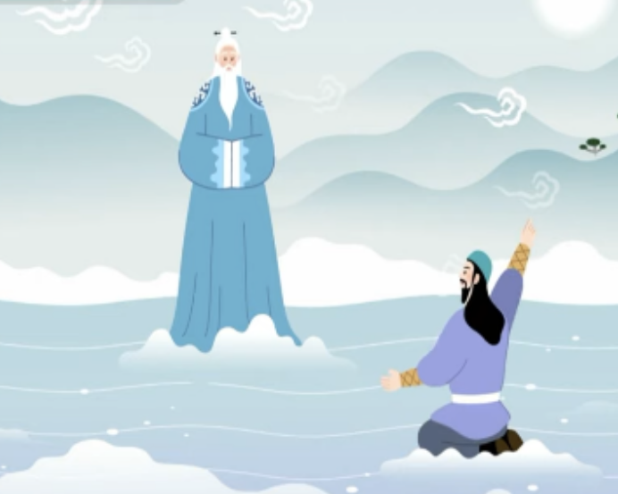
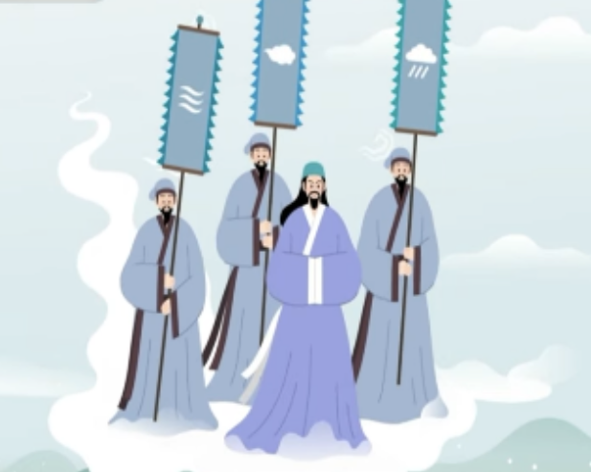
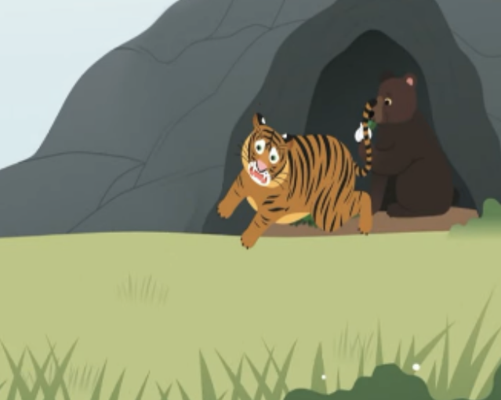
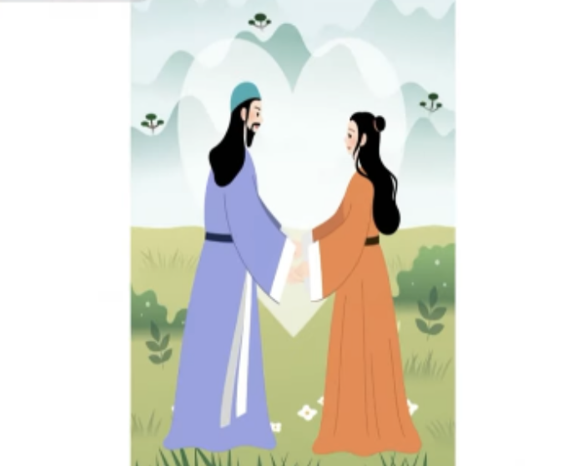
환인
환웅
바람의 신
비의 신
구름의 신
선민 사상
농경사회
곰
호랑이
웅녀
마늘과 쑥을
먹고 참아냄
(인내)
토테미즘
(Totemism)
Notes:
Let’s look at the meaning behind the characters from the story. 환웅 is a person who had been chosen by the sky, and the gods of wind, rain, and clouds meaning that 고조선 considered farming very important. People worshiped tigers and bears, and the two animals represented the two tribes of people. This shows the totemism existed in society at that time. 웅녀 who became a woman after eating only garlic and mugwort, who married 환웅, means that the bear-worshiping tribe united with the heaven-worshiping tribe, and that patience was an important value.

Slide 10
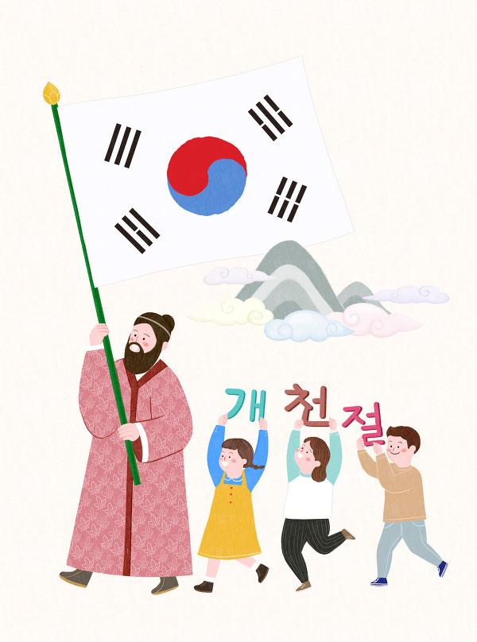
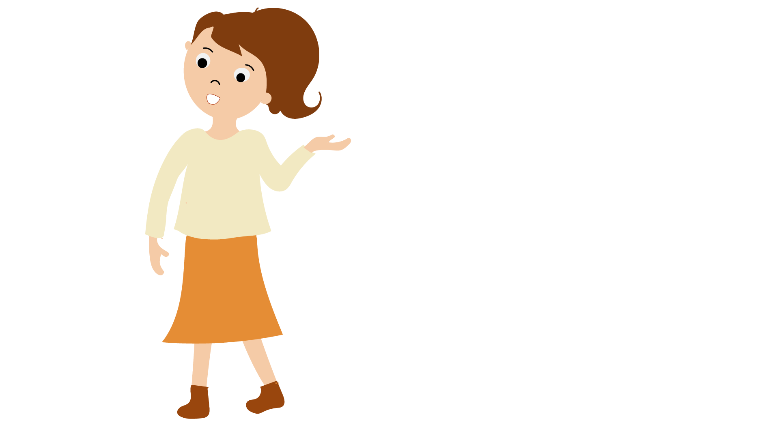
개천절은
10월 3일
개천절은
언제일까?
‘하늘이 열린 날’이라는 뜻
Notes:
The day to commemorate the establishment of 고조선 is called개천절, National Foundation Day. It is on October 3rd, and the name means the day the sky was opened.

Slide 11
단군왕검
고조선이 세워진 때
기원전 2333년
고조선을 세운 국조
홍익인간
건국이념
10월 3일
개천절
Notes:
Let’s summarize what we’ve learned.
<click> (선 연결 후 설명 자동재생) 단군왕검 founded 고조선.
<click> (선 연결 후 설명 자동재생) 고조선 was built in 2333 BC.
<click> (선 연결 후 설명 자동재생) ‘홍익인간’ is the founding philosophy of 고조선 which means ‘widely benefiting humans.’
<click> (선 연결 후 설명 자동재생) October 3rd is 개천절, the National Foundation Day.

Slide 12
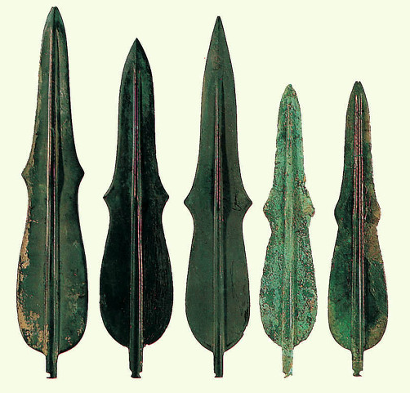
비파형 동검
전쟁 무기
제사 도구
Notes:
One of the three relics that determine the territory of 고조선 is 비파형 동검. It was a weapon, a ritual tool, and a symbol of power.

Slide 13
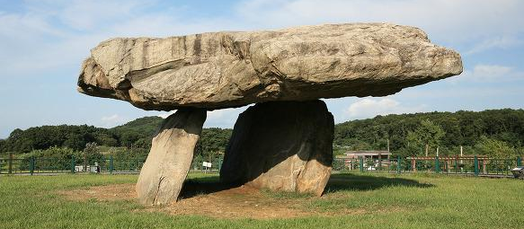
탁자형 고인돌
청동기 시대의 대표적 무덤
지배 계급과 피지배 계급
Notes:
Another of the three relics that determine the territory of 고조선 is 탁자 모양 고인돌. You can see that there was a ruling class and a dominated class.

Slide 14
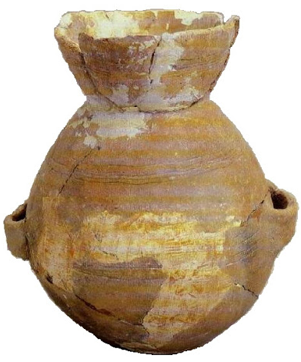
미송리식 토기
      농경 사회/ 정착 생활
      음식 조리와 저장
Notes:
The third of the three relics that determine the territory of 고조선 is 미송리식 pottery. It was a bowl for storing and cooking food, you can see that 고조선 people settled in one place and farming was very important.

Slide 15
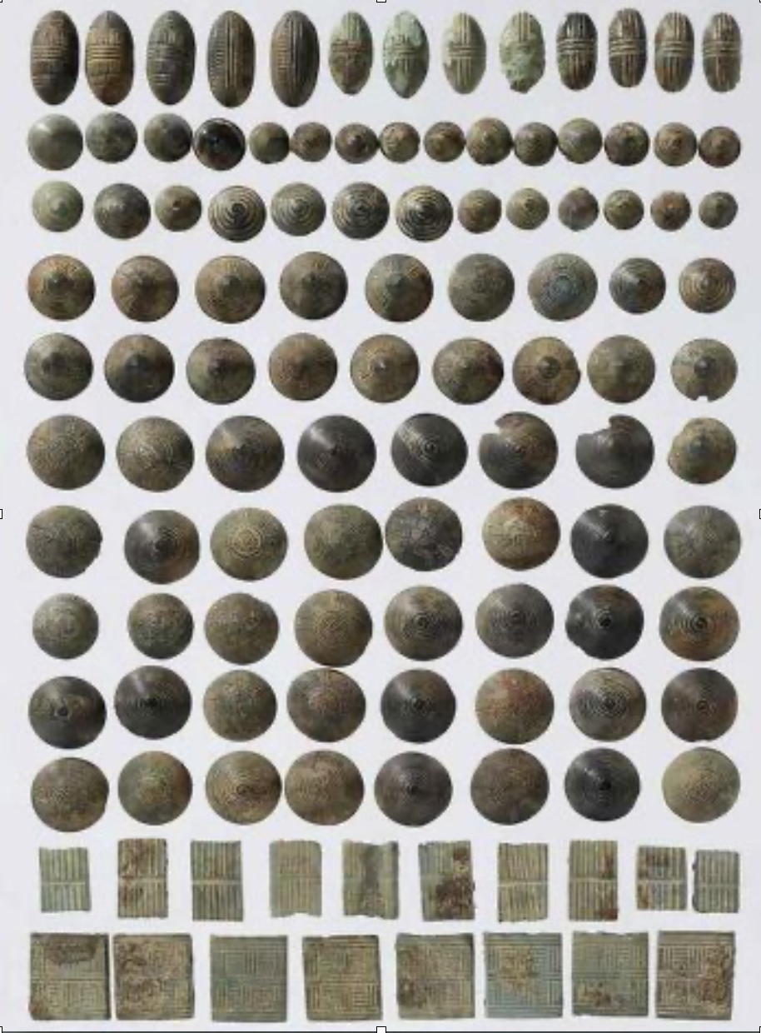
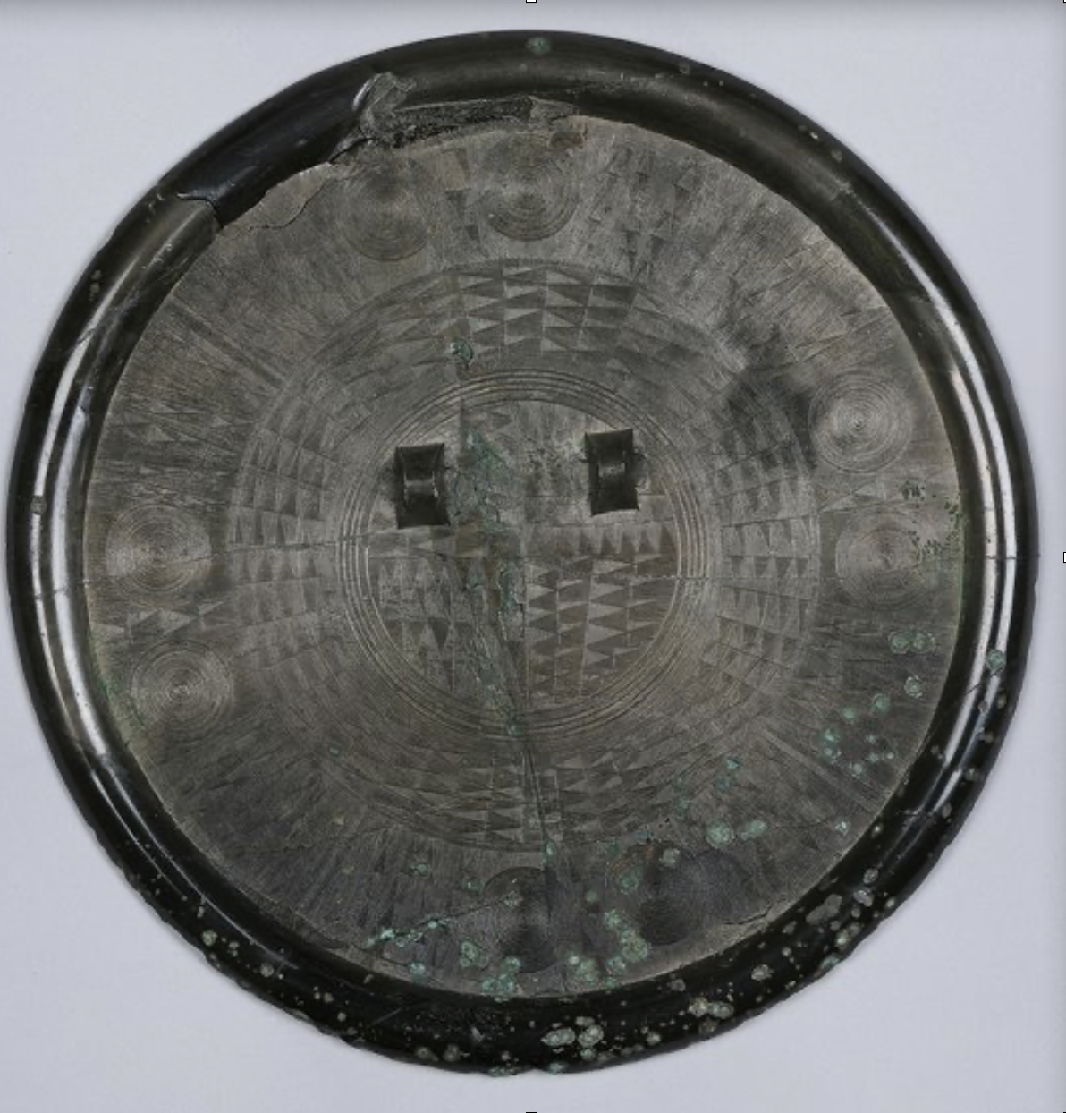
청동 거울/청동 단추
Notes:
They are bronze mirrors and bronze buttons.

Slide 16
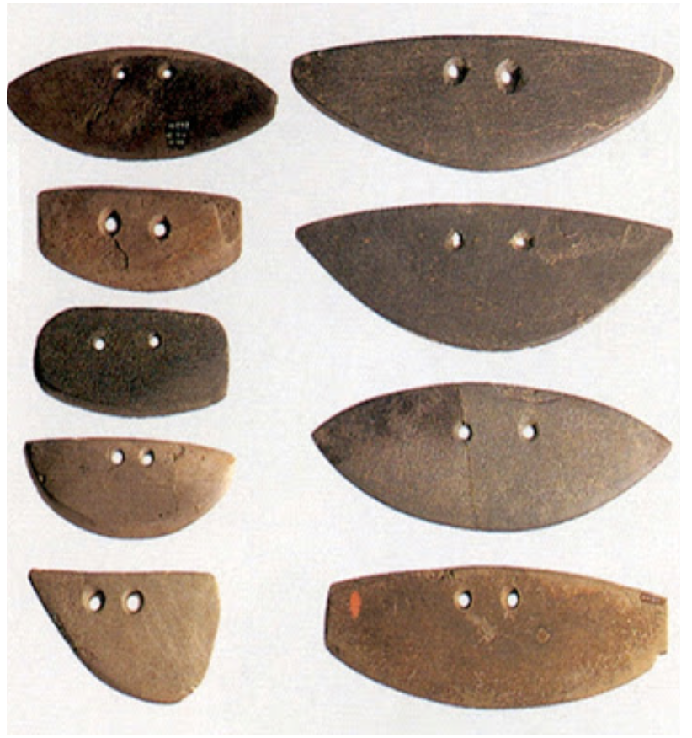
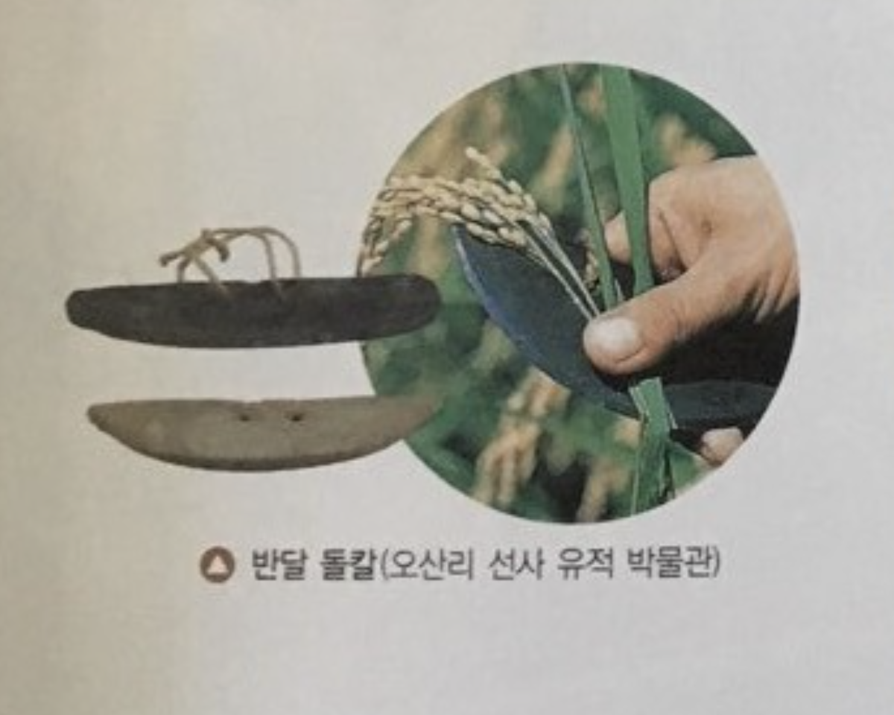
반달 돌칼
Notes:
It is a half-moon stone knife, 반달 돌칼 used in farming. It was used with a string put in the two holes to pick or cut the grain like the picture. The Bronze Age doesn't mean that only items made of bronze were used.

Slide 17
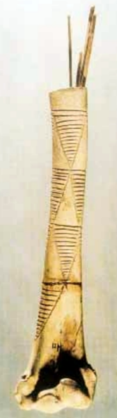
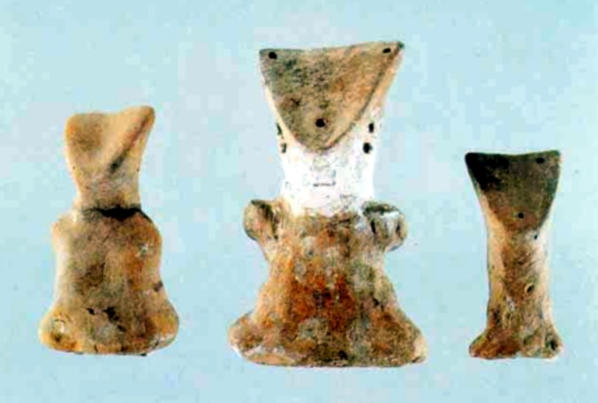
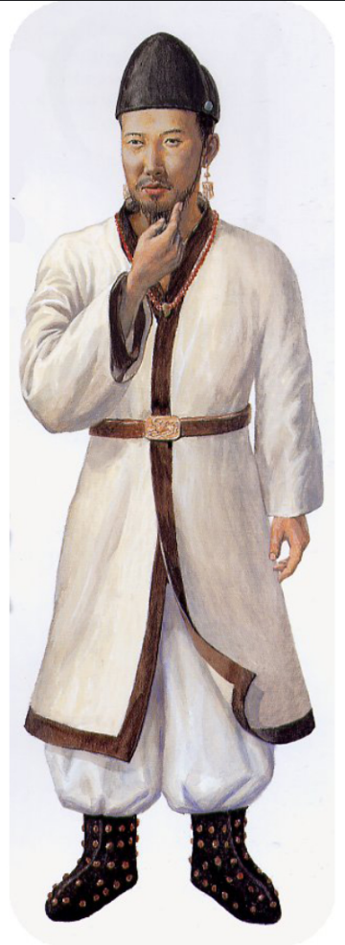
의생활
바늘통(서포항 유적)
남자 모양 흙인형(서포항 유적)
고조선을 계승한 부여의 복식
Notes:
Look at these pictures. The first picture is a needle box. 고조선 people kept needles in a bone box. We can tell that they thought making clothes was very important by looking at this bone needle box. The picture in the middle is of a clay doll wearing a hat. It seems that the people of 고조선 enjoyed wearing hats. The photo on the right is an outfit the 부여 people inherited from 고조선. Since it is a country that inherited 고조선, the clothes of the people of 고조선 would be similar.

Slide 18
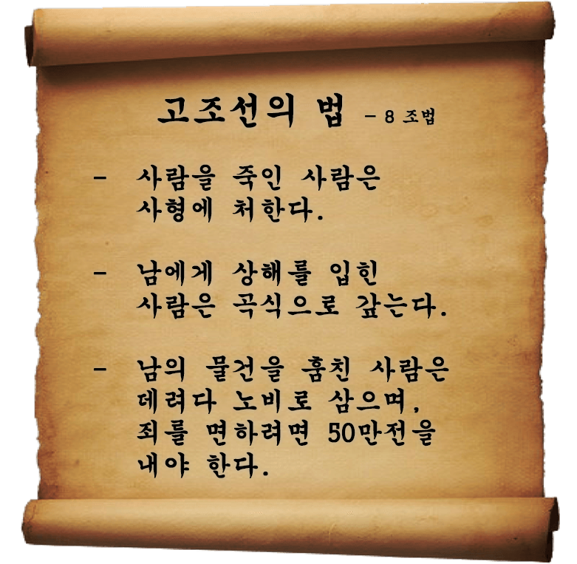
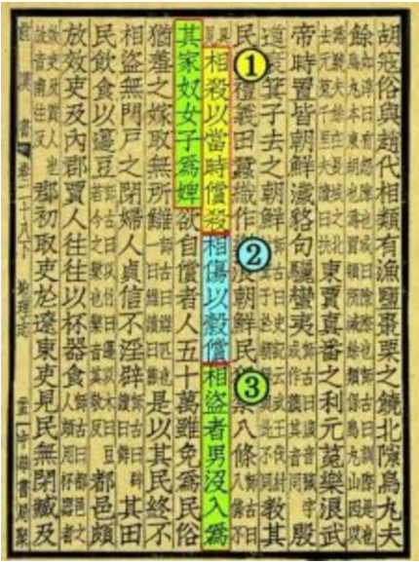
정치
  8조법
  < 한서 >
Notes:
Were there laws in 고조선? There was a law that allowed people to settle down, farm, and maintain social order as the number of people in the group increased. There is a record of 고조선's eight articles in the Chinese history book '한서', but only three are known. The first law is anybody who kills another person will be put to death. The second law is that those who hurt others should pay back damage with grain. And the third law is that anybody who steals from someone else will become a slave or should pay with money.

Slide 19
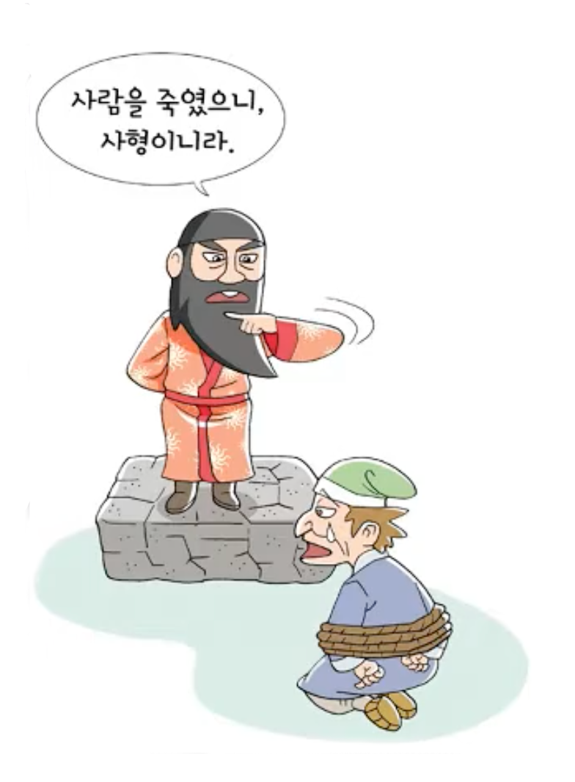
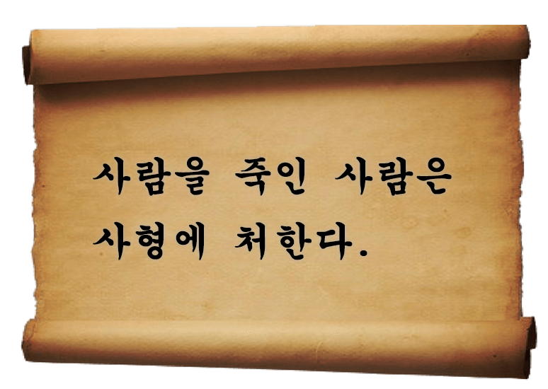
생명 존중
법으로 다스림
Notes:
The first article, ‘anybody who kills another will be put to death’
<click> (글씨 나온 후 자동재생) Through this, we know that 고조선 people valued human life and governed people by law.

Slide 20
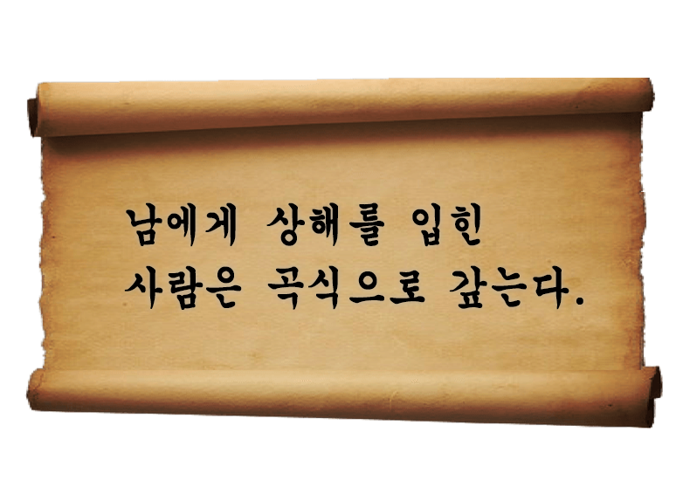
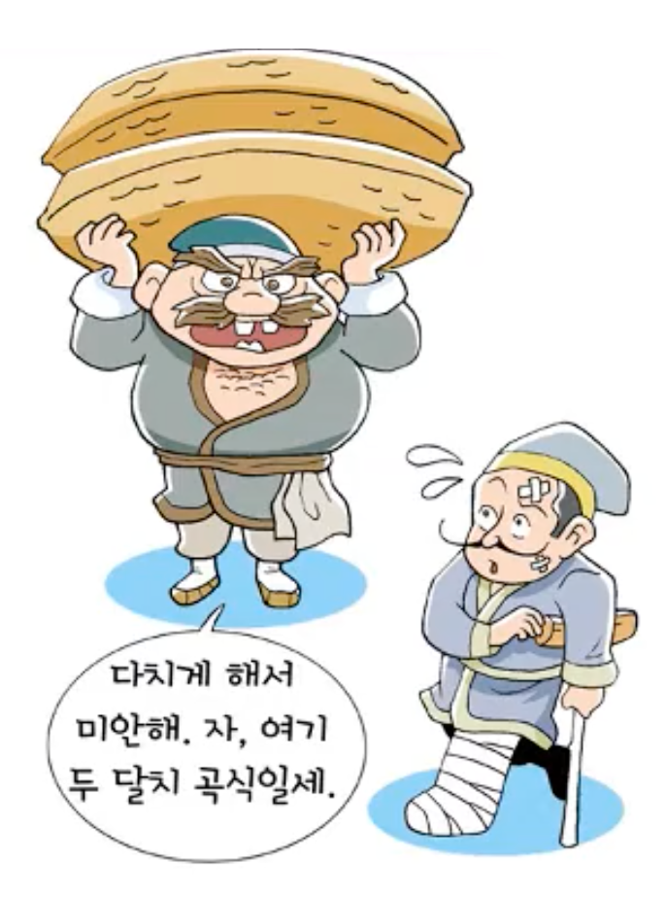
사유 재산
농경 사회
노동력 중시
Notes:
The second article, ‘those who hurt others should pay back damage with grain.’
<click> (글씨 나온 후 자동재생) Through this, we know that there was a concept of private property and 고조선 was a agricultural society, and they valued labor.

Slide 21
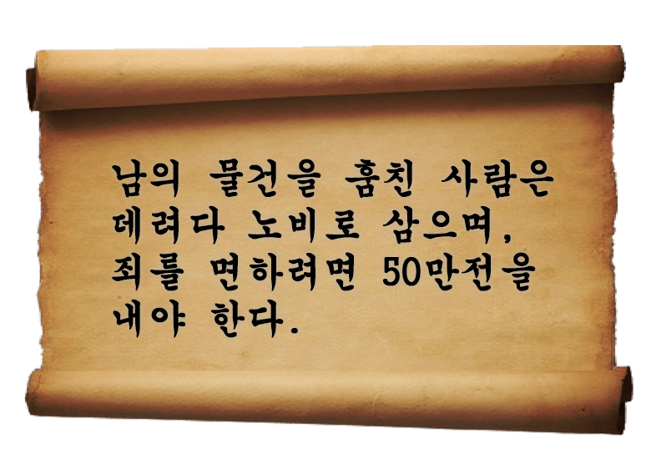
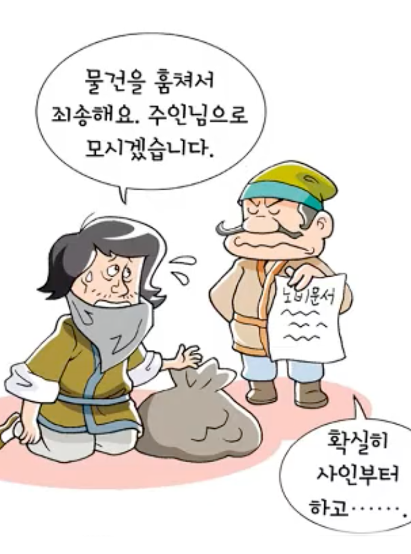
신분 제도
계급 사회
화폐 사용
Notes:
The third, ‘ anybody who steals from someone else will become a slave or should pay with money.’
<click> (글씨 나온 후 자동재생) Through this, we know that there was a social class system and they used money.

Slide 22
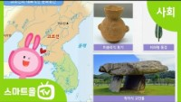
https://www.youtube.com/watch?v=UUwMMgX2hOw&feature=emb_title
Notes:
Let’s watch a video about 고조선 law.

Slide 23
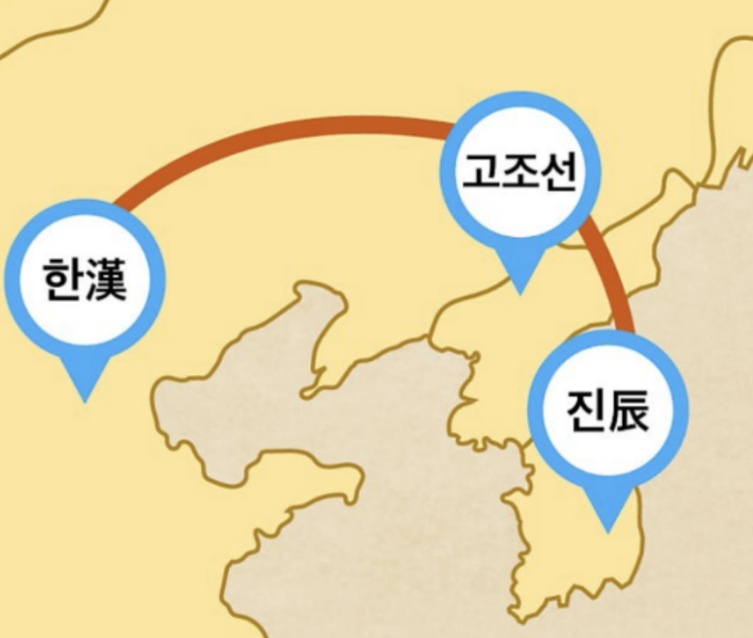
경제
  무역 경로
Notes:
고조선 made brokerage trade between China and countries in the southern part of the Korean Peninsula.

Slide 24
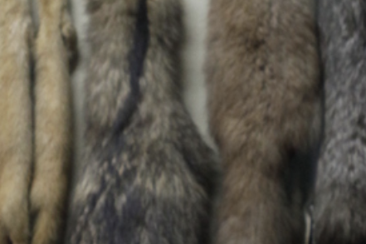
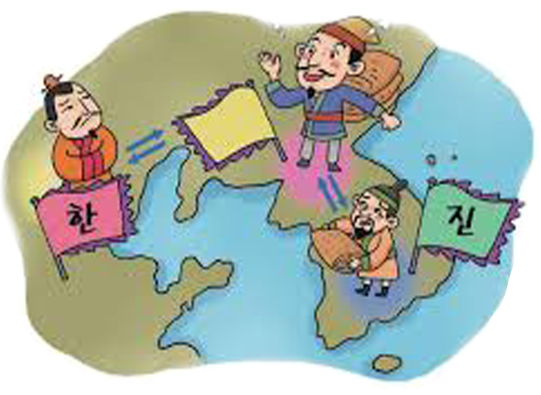
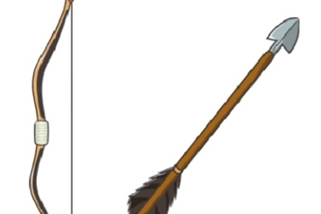
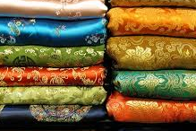
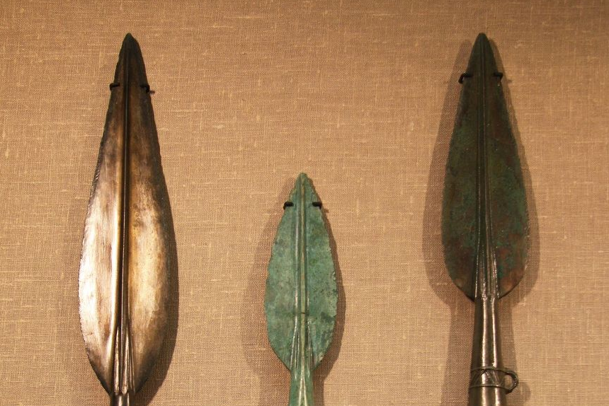
  중개 무역
모피
우리 고조선을
통해 편리하게
무역 하세요
화살
고조선
비단
구리
Notes:
Fur, arrows, silk, and copper were goods for trading.

Slide 25
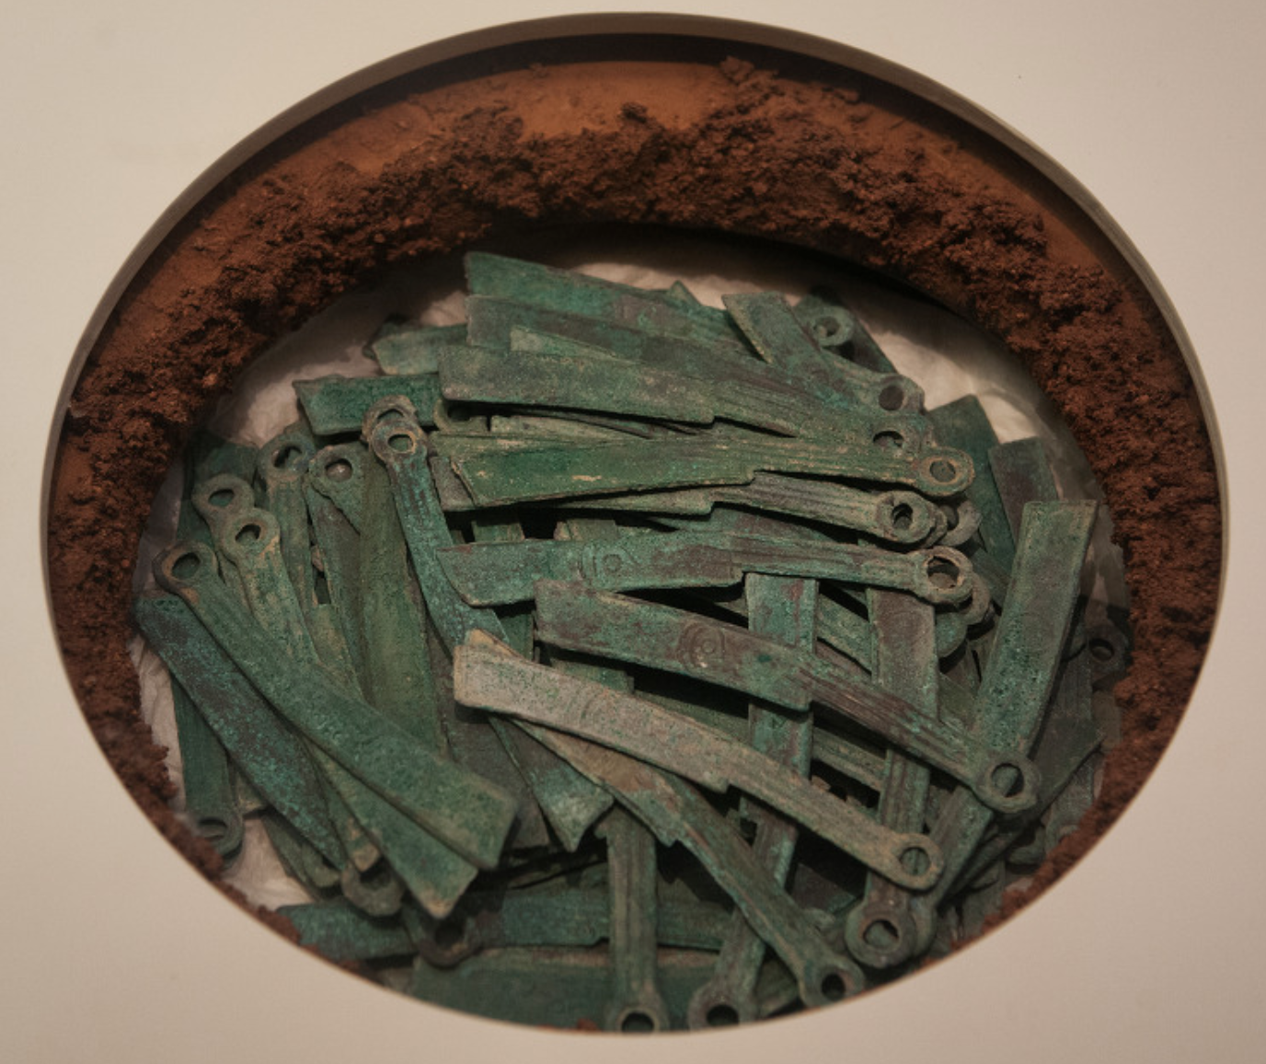
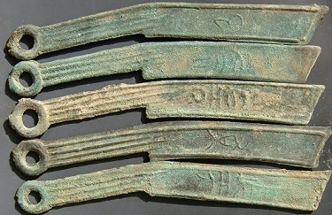
  화폐사용
  명도전
Notes:
It is a currency called 명도전 found in the ruins of 고조선. It is a currency used in ancient China, and it seems to have been used for trading.

Slide 26
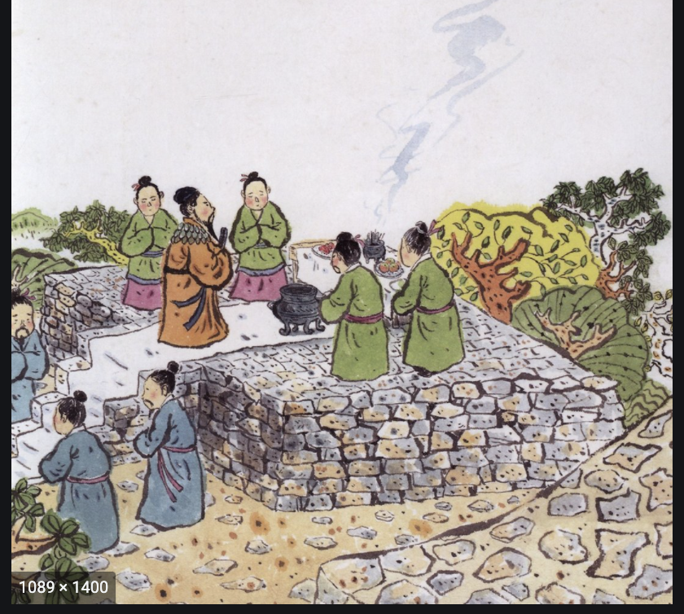
종교
하늘 신 숭배
봄과 가을에
하늘에 제사를 지냄
Notes:
고조선 worshiped a god of heaven. 고조선 people built an altar and offered sacrifices to the sky.

Slide 27
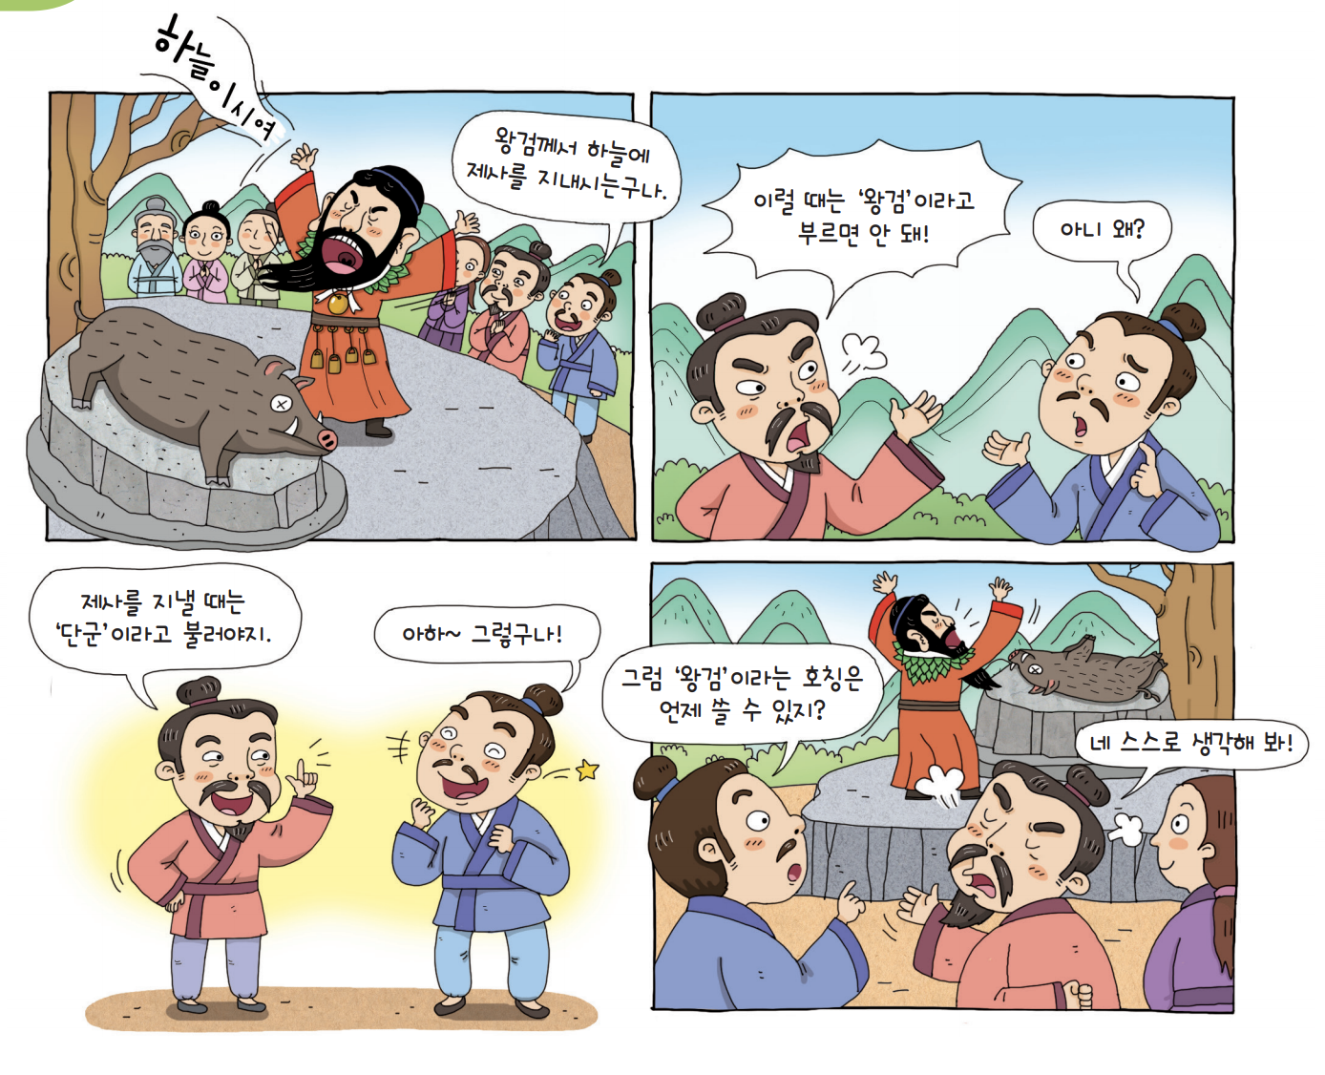
제정 일치
Notes:
단군왕검 was a priest and also a political leader.

Slide 28
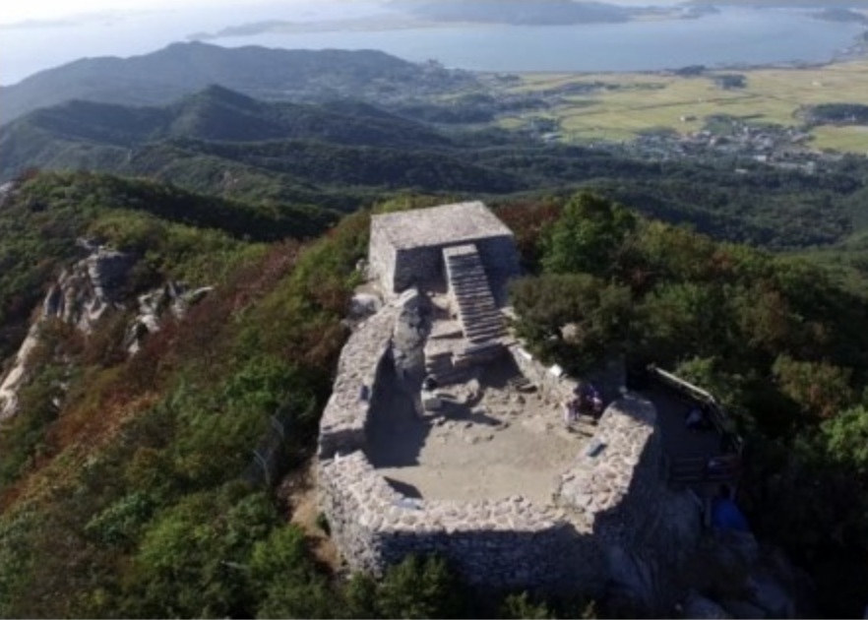
참성단
  강화도 마니산에
  쌓은 제단
Notes:
It’s the “참성단” in 마니산, 강화도. It was a place where rituals were held to the sky during the 고조선 time, and now it is a place where the torch used for the national sports festival is lit every year.

Slide 29
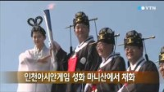
  참성단 점화 모습
https://www.youtube.com/watch?v=zAxbfOO4a8Q
Notes:
Let's watch a video of the Olympic torch for the 인천 Asian Games.

